Slide 1
Major Appliance Network Optimization
Nisarg Dave
Ruta Deshmukh
April 21, 2022

Slide 2

Network Optimization
GOAL
Optimize our network of technicians to serve more customers over the time.
Network optimization creates efficient market setups, reduces drive times, target right customers and help with capacity planning.
Notes:
Demand
Capacity
Scheduling
Routing

Slide 3





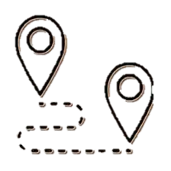
Workstreams
Reduce excessive drive time and free up capacity
Estimate demand and direct marketing spend to serve right customers in right markets
Increase overall capacity to serve more customers based on dynamically changing demand
Serving customers based on geospatial awareness and capacity
Tech Radii
Forecasting
Zone Optimization
Route Management

Slide 4
Demo: MAZO App
http://mazo.dsc.npr.aws.asurion.net:8501/

Slide 5
KPIs Impacted (March YTD)
2.2
$182
Completes per tech per day
Customer acquisition cost
Goal 2022:
5 completes per tech per day
Goal 2022:
$60 Marketing CAC

Slide 6
KPIs Impacted - Completes per tech per day
Current Performance
2022 Goal
2.2
5
Completes per tech per day
Completes per tech per day
We complete ~50% of the bookings per tech per day.
To complete 5 jobs/tech per day we need to book 9 jobs/tech per day.
Using zone optimization, we can squeeze in 2 additional bookings per tech per day.
Daily
Bookings*
1,668
4.57 jobs
per tech per day
Daily visits*
1,305 (-20%)
Daily completes*
754 (-50%)
2.2 jobs
per tech per day
** Funnel shows sum of bookings including all markets for a day in March

Slide 7
Zone Optimization
We serve a larger than optimal market coverage. Leading to higher miles driven per tech per day.
Reducing the coverage to serve 40% of the area can free up tech’s time to complete more jobs:
For Samsung: Limited availability in hard-to-reach zip codes
For D2C: Reduce coverage to core market areas generating most of the demand
80%
of our demand comes from 40% of our market coverage

Slide 8
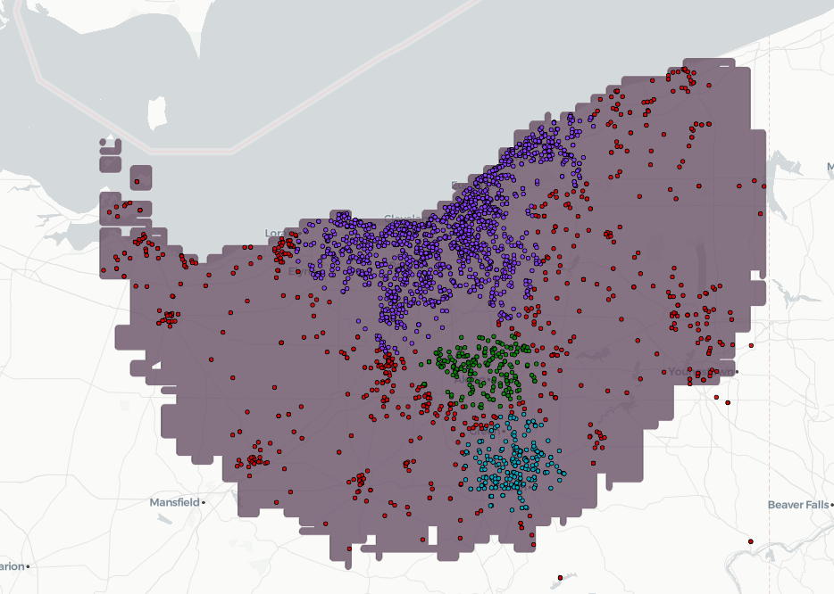
Cleveland market coverage
70 miles
2 hours
Islands near Sandusky take entire day to travel.
*Avg miles tech drives
*Avg duration tech drives
Total zip codes covered (OEM+D2C):
309
3,254
Jobs in last 24 months
5
Bookings per day per tech
Completes per day per tech
Each dot represents an Asurion repair from Cleveland market.
Red dots are jobs that take significant travel time for techs.
2
* Avg miles and Avg durations are calculated using simulations

Slide 9
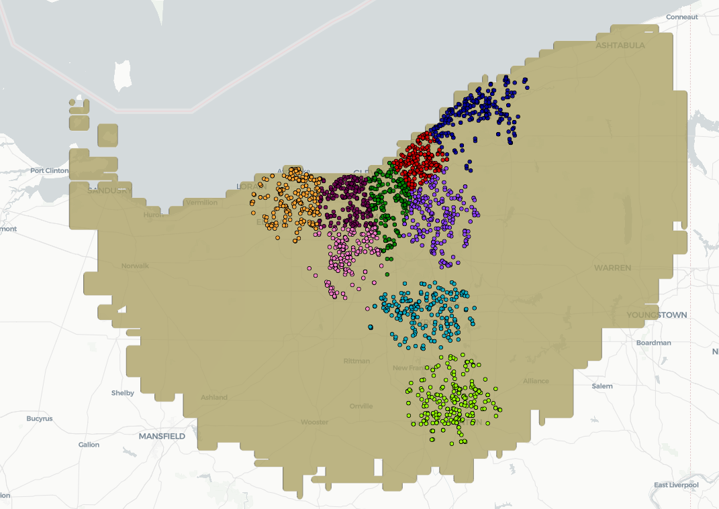
Cleveland market coverage – Proposed
32 miles
1 hour
Avg miles tech drives
Avg duration tech drives
Reduce zip codes covered (OEM+D2C)
127
Reduce coverage to cover T-zone and get 1+ additional jobs scheduled per tech per day
80% of current job volume is covered
2,554
Add 1-2 bookings to tech’s schedule
5 + 2
Each dot represents an Asurion repair from Cleveland market.

Slide 10
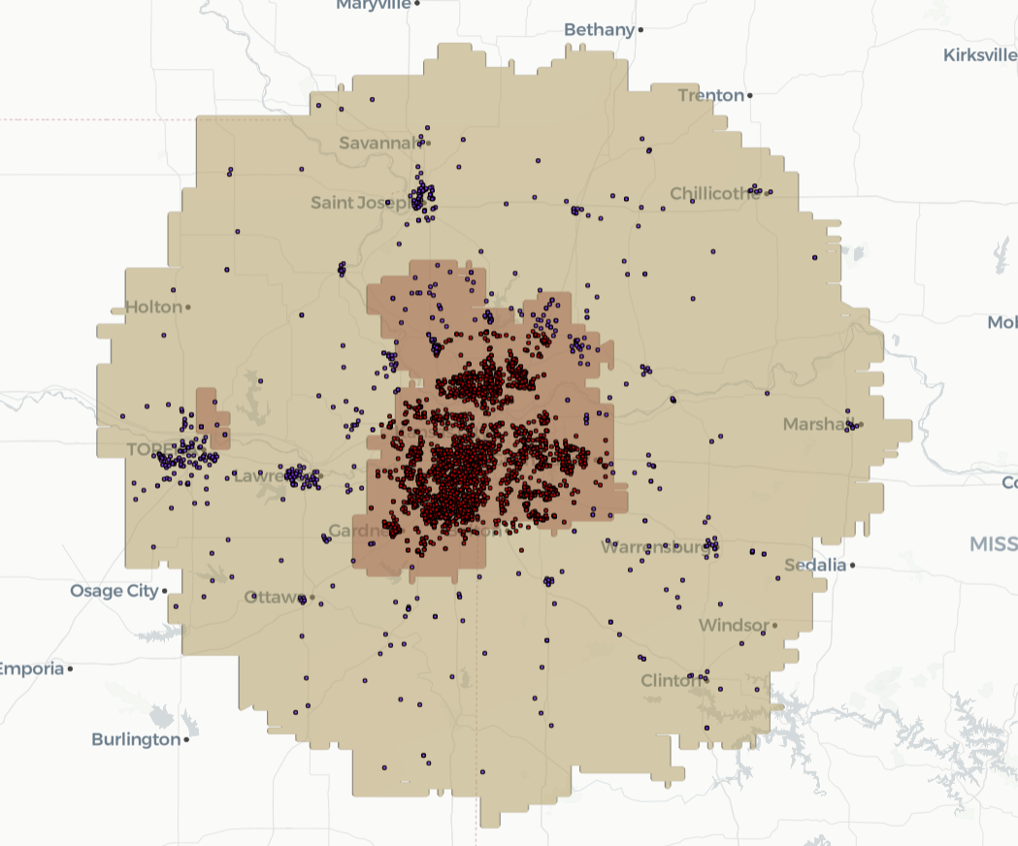
Kansas city coverage
150 miles
4 hours
*Avg miles tech drives
*Avg duration tech drives
Total zip codes covered (OEM+D2C):
355
4,139
Jobs in last 24 months
5.5
Bookings per day per tech
Completes per day per tech
2.7
Dots on the map represent locations of customer who have filed a claim with Asurion from Kansas City market. Blue dots are jobs that take significant travel time for techs. Islands near Sandusky take entire day to travel for a tech.
* Avg miles and Avg durations are calculated using simulations

Slide 11
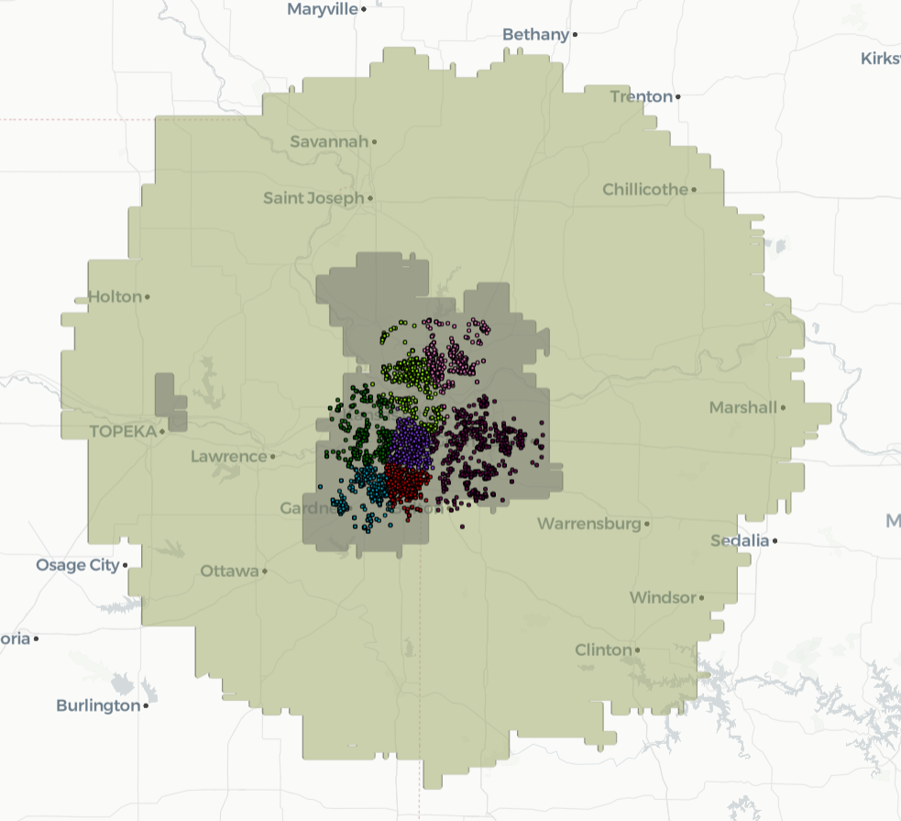
Kansas city coverage - Proposed
36 miles
70 mins
*Avg miles tech drives
*Avg duration tech drives
Total zip codes covered (OEM+D2C):
130
3,346
Jobs in last 24 months
5.5 +2
Bookings per day per tech
Dots on the map represent locations of customer who have filed a claim with Asurion from Kansas City market. Blue dots are jobs that take significant travel time for techs.
* Avg miles and Avg durations are calculated using simulations

Slide 12
Pilot proposal
LOCATION
Pick a market with low completes per day and huge coverage. Example: Cleaveland
TEST
Run jobs 5 days/week for 127 zip codes that generate 80% of our demand.
Run jobs 1-2 days/week for the rest 112 zip codes that are outliers and generate 20% of demand
TRACK
Monitor completes per day per tech and increase capacity
Monitor avg time spent driving per tech
Monitor number of unassigned jobs

Slide 13
Appendix

Slide 14
Reduce market coverage – Concerns
Do we have enough volume in T-zone to work with reduced coverage?
Will the hypotheses “80% demand come from highly populated areas in market” hold over time?

Slide 15


Demand/Capacity Forecasting
Establish data driven approach to identify the demand for the different markets. Setup the demand forecasting to reconfigure capacity (increase/decrease based on change in demand).
Objective
Estimate job volumes based on historical number of jobs
Incorporate census and demographics data for each market
Factor in advertisement and lead gen efforts
Key Result
Create mechanism to find optimal demand that can work across different markets
Use demand to adjust capacity and to influence marketing campaigns
Notes:
Actual repairs will take place at customer homes
Technicians will start day from the FSL locations and return at end of the day
Parts could be ordered/stocked at the FSL location

Slide 16
Capacity based Marketing campaigns
Marketing |  |  | Data Science | SB/Workforce Management
Markets | Volume goal | Projections | Forecasted demand | Available slots | Used slots | Remaining slots
LA | 135 | 103 | 137 | 502 | 135 | 367
Riverside | 104 | 105 | 120 | 270 | 93 | 177
Long Beach | 94 | 84 | 115 | 177 | 95 | 82
San Diego | 65 | 65 | 85 | 307 | 65 | 242
Houston | 147 | 136 | 197 | 483 | 170 | 313
Dallas | 83 | 56 | 452 | 636 | 212 | 424
Charleston | 44 | 24 | 120 | 211 | 93 | 118
Nashville | 24 | 60 | 157 | 460 | 110 | 350
Columbus | 33 | 40 | 68 | 87 | 28 | 59
Detroit | 55 | 48 | 105 | 177 | 84 | 93
OKC | 43 | 20 | 48 | 77 | 37 | 40
Raleigh | 19 | 50 | 118 | 216 | 84 | 132
Atlanta | 60 | 30 | 33 | 105 | 28 | 77
Opportunity to increase Volume goals in:
LA, Riverside, San Diego, Houston, Dallas, Charleston, Nashville, Detroit and Raleigh
Volume goals for Long Beach, Columbus, OKC and Atlanta are set up appropriately.

Slide 17

Potential
Add 1 job per tech /day
The current goal is to reduce 10miles in drive time per tech per job. This will result in $0.585/miles = ~1.5m savings over year.
This will in turn increase our ability to book more appointments. Booking at least 1 additional job and collecting diagnostics fee of 99$ = ~6m
Reduce $0.585 /miles

Slide 18
Network app rollout
Customer
Solutions:
Help establish tech coverage for markets we are launching next
What if we start using the App’s recommendations as baseline
Action: Pick markets that DS can help with
Get daily feedback from Raz until the solution is delivered
Markets in pipeline for tech-zone:
Atlanta-OEM | 3/7/2022
Grand Rapids | 3/7/2022
San Antonio-OEM | 3/7/2022
Raleigh-OEM | 3/7/2022
Seattle | 3/7/2022
Denver-OEM | 3/8/2022
Alexandria-OEM | 3/8/2022
Long Beach-OEM | 3/8/2022
Boston | 3/11/2022
Riverside-OEM | 3/11/2022
San Diego-OEM | 3/11/2022
Daytona | 3/14/2022
Fort Myers | 3/15/2022
Nashville-OEM | 3/16/2022
Des Moines-OEM | 3/17/2022
Los Angeles-OEM | 3/17/2022
Workforce
Management:
Help with daily forecasts, evaluate against actual demand
Readjust forecast to support capacity planning
Action: Add forecasts to App

Slide 19
Why to optimize network?
01
02
03
ServiceBench network setup
Managing ServiceBench network setup is difficult, error prone, and lacks transparency
Misaligned network setup
Misconfigurations increase CAC and directly impact how many customers we can serve
Optimization
By optimizing geo-coverage, capacity, demand, we can reduce CAC and improve our overall efficiency

Slide 20
Tech Radii
Asurion has rolled out service in 44 markets across USA for Major Appliance repairs in 2021. A team of technician covers the claim volume in each market. Can we minimize drive time for each market by minimizing drive times for each individual.
Objective
Minimize drive time for technicians in the market
Divide each market into areas of coverage based on job volume
Create market fragments by assigning techs to radii near their homes
Key Result
Reduce driving distance by 10 miles per tech route thus reducing CAC.
Create mechanism to find optimal clusters for each markets
Create a self-service UI that can make necessary computations with changes in parameters like tech locations
Notes:
Actual repairs will take place at customer homes
Technicians will start day from the FSL locations and return at end of the day
Parts could be ordered/stocked at the FSL location

Slide 21
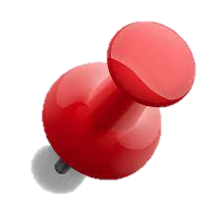



What’s next with App
Current feedback
Faster output of clustering (done)
Selection in # of clusters does not reflect in map (done)
Get address of cluster centroids (done)
Show home addresses of techs on map (done)
Ability to draw polygon and redefine coverage (scoping)
Select cluster center by putting a pin on map (scoping)
Adjust radii of the circle using the map visual (scoping)
Demand forecasting
Simulations
% Unassigned jobs

Slide 22







Current setup and opportunities
SCHEDULING PROCESS
Journey continues with pre-repair
My appliance is not working correctly
I call the OEM
I receive a call from Asurion within 24 hours
(3 call attempts + SMS)
Initial diagnosis appointment is scheduled
Expert visits customer and orders parts and schedule 2nd appointment for part installation
If the parts will arrive after my original appt, the NSC team reschedules
1 day prior
Job readiness,
Truck stock
I look up “Appliance repair near me” and go to Asurion website
I call Asurion for support with my appliance
Manage ads
Manage Marketing Spend
Proactively identify when market is at capacity and turn off ads
Impact: Reduce CAC for MA
Job Readiness
Predict when parts and techs are ready for every repair
Impact: Reduce reschedules, increase FTF
Truck Stock
Identify and optimize parts stocked on trucks
Impact: Increase FTF
Notes:
Actual repairs will take place at customer homes
Technicians will start day from the FSL locations and return at end of the day
Parts could be ordered/stocked at the FSL location

Slide 23
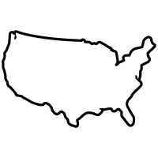
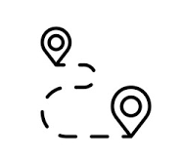
Current setup and opportunities
NETWORK SETUP
Journey continues with pre-repair
44 markets in USA:
Each market is about 100 miles radius from center of each CBSA, has 1 FSL and set of techs
Example: Tampa has 7 techs covering a radius of x miles.
Each tech covers ~6 jobs/day in the whole market
OEMs block availability for most techs for next 3 days.
Rest of the tech schedules are filled by D2C
Expert visits customer and orders parts and schedule 2nd appointment for part installation
If the parts will arrive after my original appt, the NSC team reschedules
1 day prior
Tech looks up appointments and starts making visits
Tech Zone Coverage
Routing
Demand forecasting, capacity planning
Slot management
Tech Zone Coverage
Establish better tech market coverage
Impact: Increase completes per day
Stage: POC app ready
Demand and Capacity
Balance lead-gen and demand to fully utilize capacity
Impact: Increase FTF and completes per day
Stage: POC WIP
Routing/Slot management
Place jobs on techs schedule to reduce re-routing
Impact: Increase completes per day
Stage: Ideation
Notes:
Actual repairs will take place at customer homes
Technicians will start day from the FSL locations and return at end of the day
Parts could be ordered/stocked at the FSL location

